Slide 1
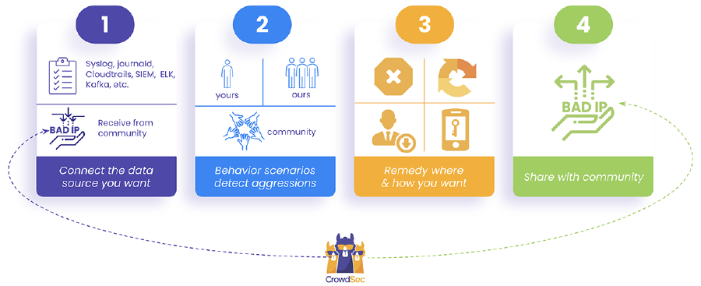

Slide 2
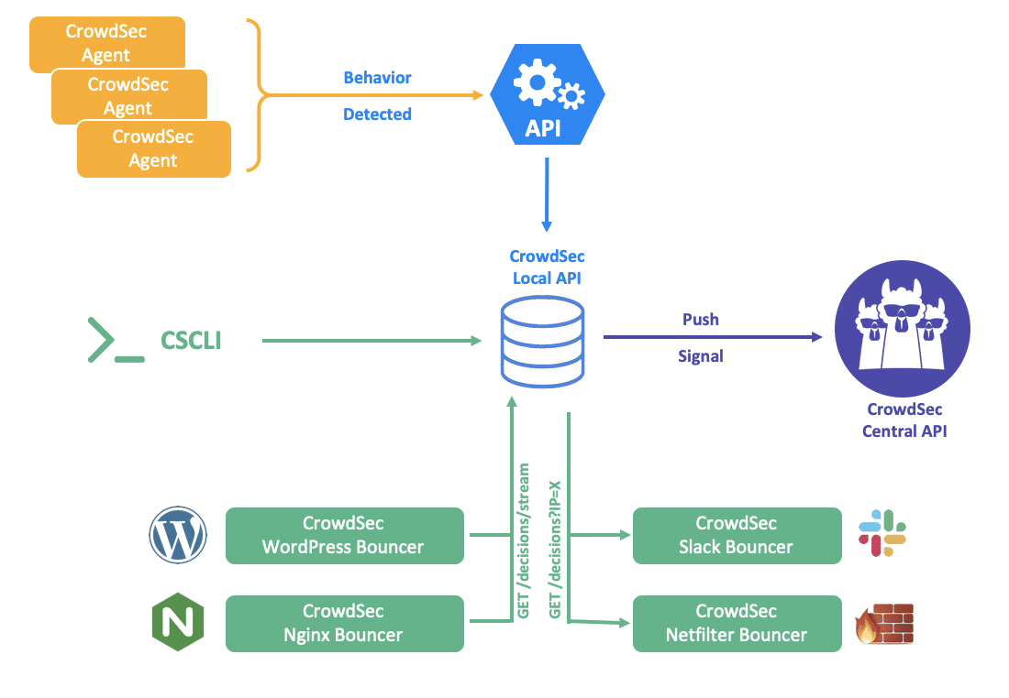
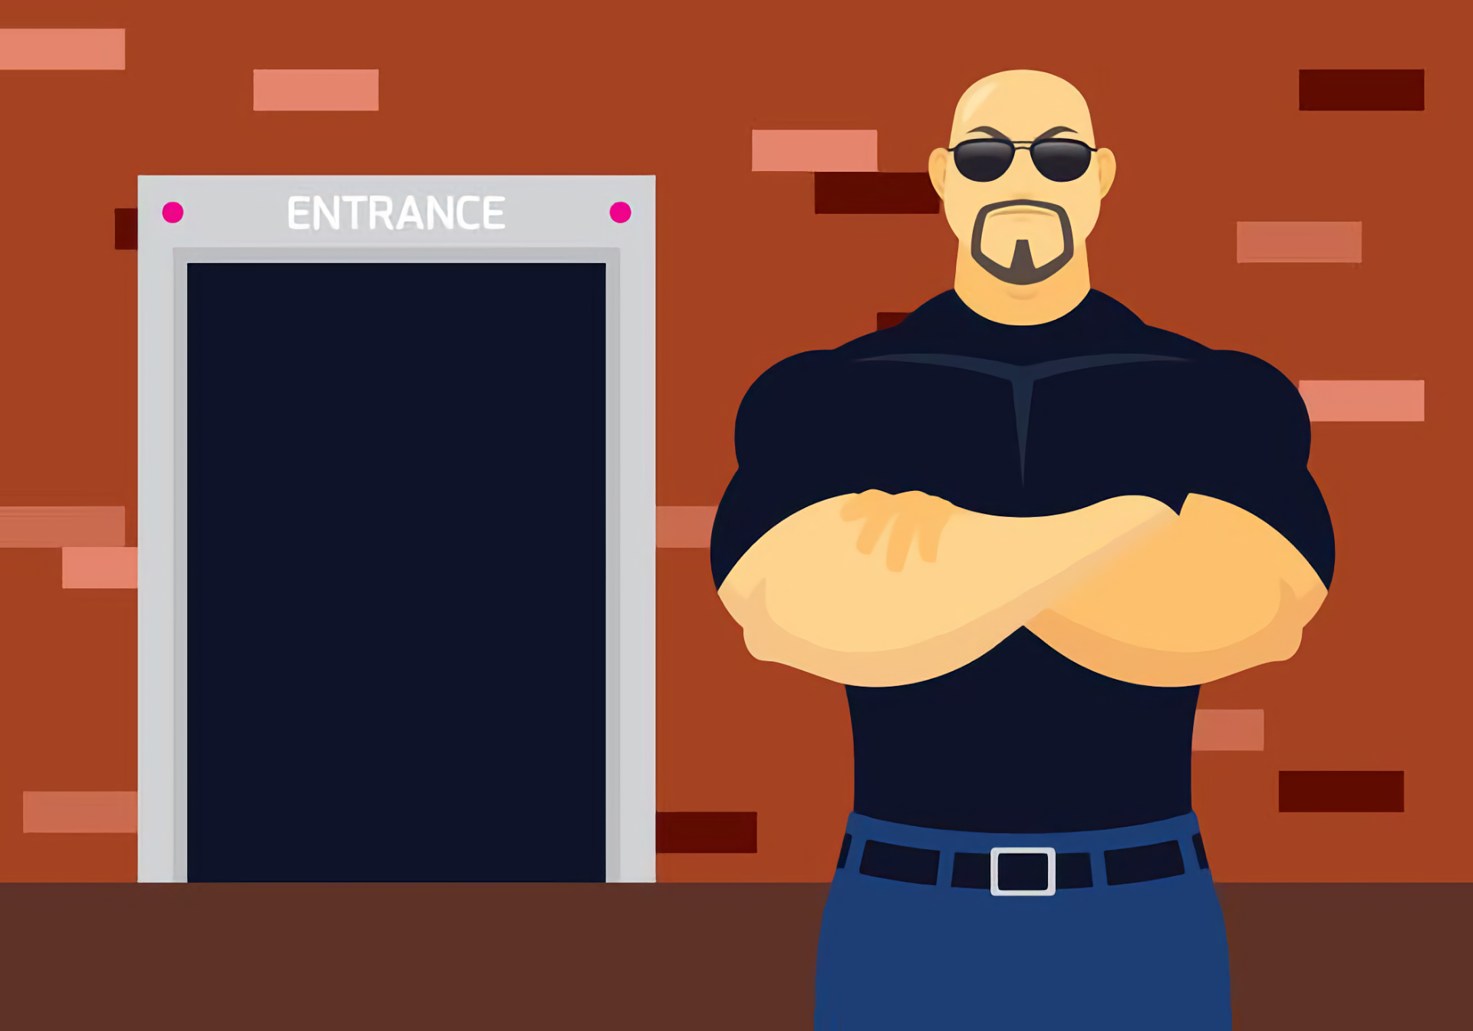

Slide 3
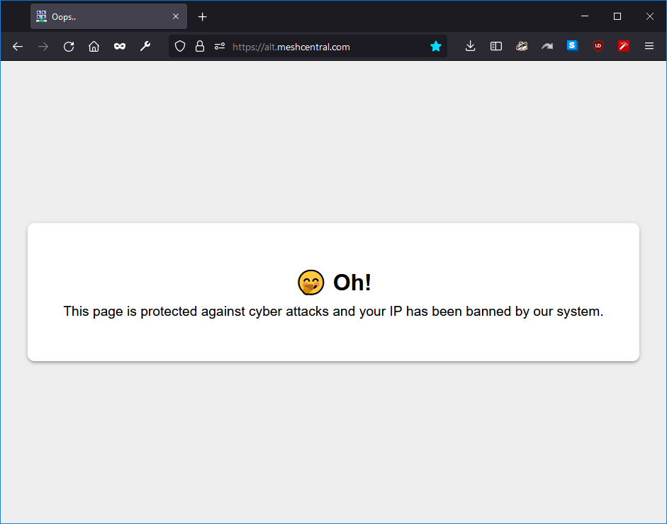
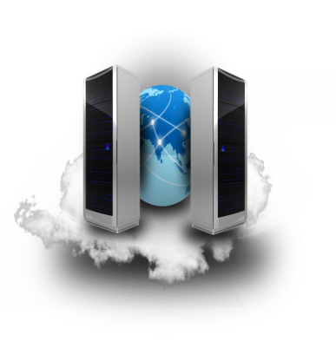
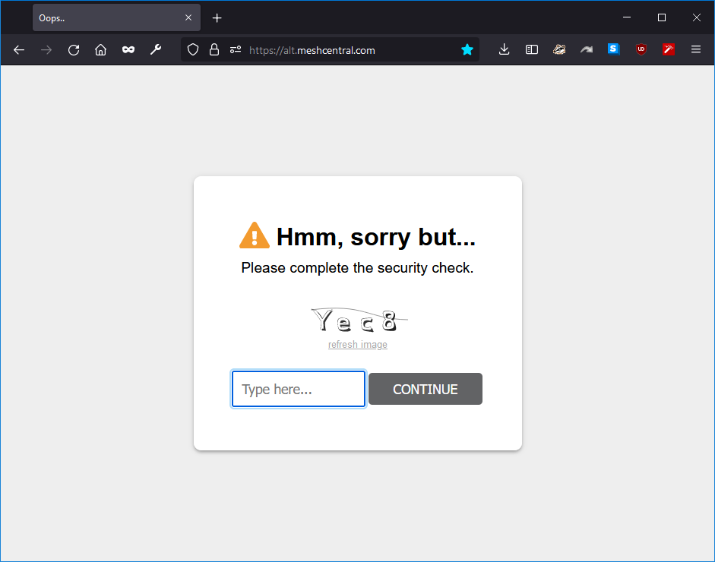
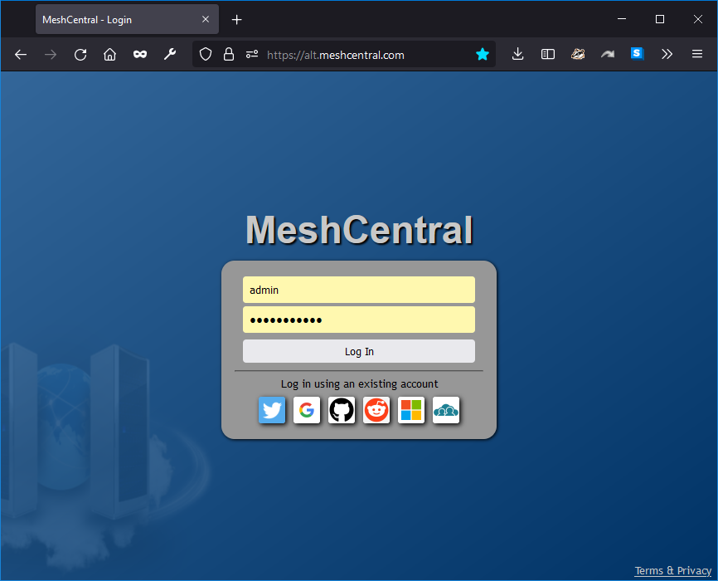

MeshCentral

Slide 4
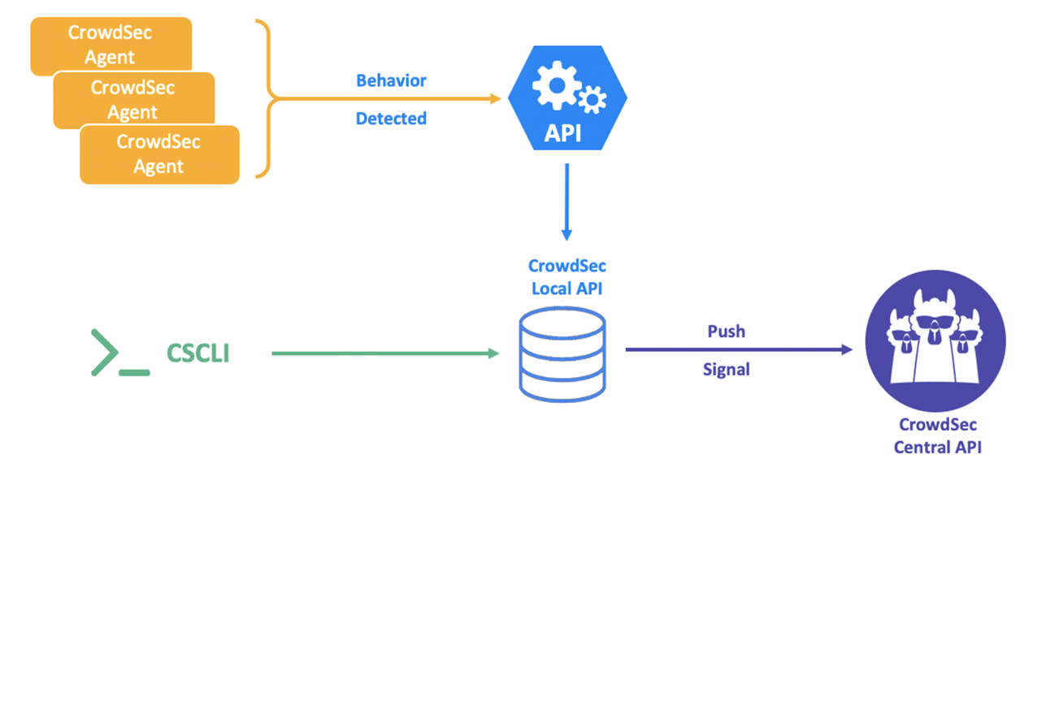
MeshCentral

Slide 5
Config.json
{
"settings": {
"crowdsec": {
"url": "http://localhost:8080",
"apikey": "8a3df2ccf831069bf7efc567331f1b15",
"fallbackremediation": "captcha"
},
}
}

